Slide 1
Angular best practice 12-08-2016 nguyen ngoc san - senior front-end developer

Slide 2
AGENDA
Angular common issues
Form and input
Angular dependency injection
Angular view rendering and $timeout
Q&A

Slide 3

ANGULAR MODULE

Slide 4
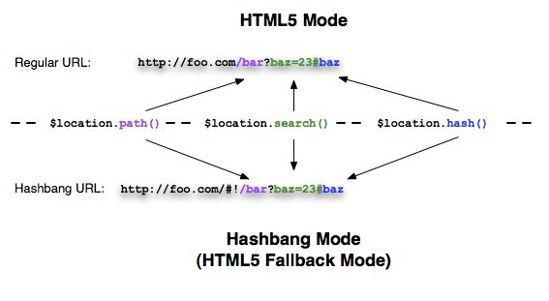
$location
Notes:
https://docs.angularjs.org/guide/$location

Slide 5
$location
URL: http://foo.com/#/abc => http://foo.com/abc
$locationProvider.html5Mode(true);
Add tag <base href=“/” >
Using this mode requires URL rewriting on server side, basically you have to rewrite all your links to entry point of your application (e.g. index.html).
Server side: how to configure rewrite url

Slide 6
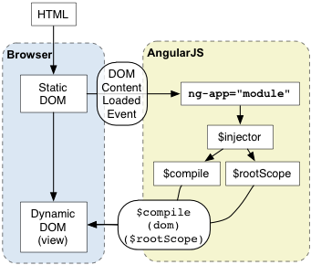
Angular bootstrap
Notes:
https://docs.angularjs.org/guide/bootstrap
Using manual initialization if you need to perform an operation before Angular compiles a page

Slide 7
Angular bootstrap
<script>
angular.module('myApp', [])
.controller('MyController', ['$scope', function ($scope) { $scope.greetMe = 'World';
}]);
angular.element(document).ready(function() { angular.bootstrap(document, ['myApp']);
});
</script>

Slide 8
In Cordova app must use bootstrap
var app = {
bindEvents: function () {
document.addEventListener('deviceready', this.onDeviceReady, false);
},
onDeviceReady: function () {
angular.bootstrap(document, ['myApp']);
}
},
app.initialize();
Notes:
Cordova_app/www/index.js

Slide 9
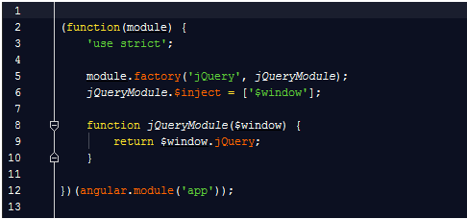
Angular inject third party as service

Slide 10
Angular service
angular.copy not work with blob object => it does not clone another object, instead of, it refer to current object.
function cloneBlob (source) {
if (source instanceof Blob) {
return source.slice(); // clone file
}
}
Using: $location, $timeout, $interval instead of window.location, window.setTimeout, window.setInterval.

Slide 11
FORM AND INPUT

Slide 12
Angular Form
If the name attribute is specified, the form controller is published onto the current scope under this name.
<form name=“formA”></form>
$scope.formA => object contains $error, $valid …
<form name=“”formB” ng-if=“isShowFormB”></form>
$scope.formB => undifined
Notes:
https://docs.angularjs.org/api/ng/directive/form

Slide 13
Angular Form - Custom Validation
Angular provides basic implementation for most common HTML5 input types, as well as some directives for validation.
Create custom directive and add validation functions to $validators object on the ngModelController
The directive must require ngModel
Each function in the $validators object receives the modelValue and the viewValue as parameters
Validation happens after successfully running$parsers and $formatters
Failed validators are stored by key in ngModelController.$error
Notes:
https://docs.angularjs.org/guide/forms

Slide 14
Angular Form Input
ngModelController will check validation for all input fields even though they are hidden field.
Carefully with input[date] => valid date.
Initialize: ngModel = null; => input invalid date: 02/30/2016. ngModel = null & input.$valid = true.
ngModel existed value => input invalid date. ngModel = null & input.$valid = false.

Slide 15
DEPENDENCY INJECTION

Slide 16
Angular dependency injection
When the application bootstraps, Angular creates an injector that will be used to find and inject all of the services that are required by your application.
The injector only carries out the following steps:
Load the module definition(s) that you specify in your application.
Register all Providers defined in these module definition(s).
When asked to do so, lazily instantiate services and their dependencies, via their Providers, as parameters to an injectable function.
Notes:
https://docs.angularjs.org/tutorial/step_09
Angular modules solve the problem of removing global variables from the application and provide a way of configuring the injector. As opposed to AMD or require.js modules, Angular modules don't try to solve the problem of script load ordering or lazy script fetching. These goals are totally independent and both module systems can live side-by-side and fulfill their goals.

Slide 17
Angular recursive dependency error
ServiceA => inject Service B => inject ServiceC => inject Service A
Using $injector to manual inject in each service’s function.
module.factory(“ServiceC”, [“$injector”, function ($injector) {
function c() {
var serviceA = $injector.get(“ServiceA”);
serviceA.doSomething();
}
}]);

Slide 18
VIEW RENDERING & $TIMEOUT

Slide 19
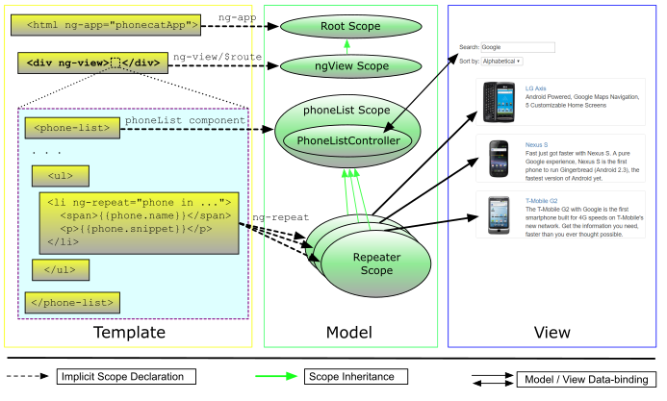
Angular view rendering with ngView
Notes:
https://docs.angularjs.org/api/ngRoute/directive/ngView
$viewContentLoaded
$routeChangeSuccess
If ngView is contained in an asynchronously loaded template (e.g. in another directive's templateUrl or in a template loaded usingngInclude) => Using $timeout to check whether subView is rendered or not.

Slide 20
ngView contain asynchronously loaded template
View contain ng-include or directives. How to check whether all child views are loaded?
Browser task include: javascript execution and DOM rendering. $timeout(function () {…}) => push JS execution queue and will be run after DOM rendering.
All directives should expose API to check whether view is loaded.
Parent controller will create an object to check child’s view is loaded or not.
Notes:
https://docs.angularjs.org/tutorial/step_09

Slide 21
Q&A

Slide 22
THANK YOU

